Slide 1
CSDS 451: Designing High Performant Systems for AI
Lecture 14
10/14/2025
Sanmukh Kuppannagari
sanmukh.kuppannagari@case.edu
https://sanmukh.research.st/
Case Western Reserve University

Slide 2
Outline
Distributed Training Basics
Pytorch Lightning

Slide 3
Outline
Distributed Training Basics
Pytorch Lightning

Slide 4
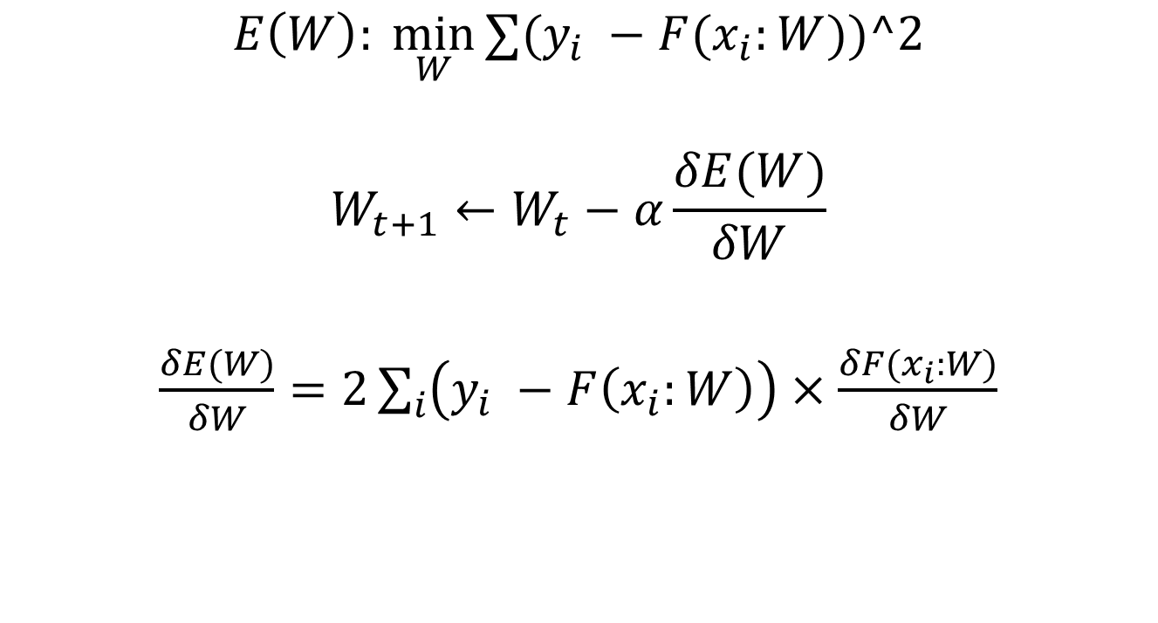
Training
$$E\left(W\right): \min_{W}{∑(y_{i} −{F(x}_{i}:W))^2}$$
$$W_{t+1}←W_{t}−α\frac{δE(W)}{δW}$$
$\frac{δE(W)}{δW}=2\sum_{i}{\left(y_{i} −F\left(x_{i}:W\right)\right)}×\frac{δF(x_{i}:W)}{δW}$
Iteratively
For all samples, in each iteration
Error

Slide 5
Training
$L$ layers in CNN
$$W_{1}, W_{2}, W_{3}, …, W_{L}$$
$$O_{1}, O_{2}, O_{3}, …, O_{L}$$
$$\frac{δF(x_{i}:W_{1:L})}{δW_{1}},\frac{δF(x_{i}:W_{1:L})}{δW_{2}},…,\frac{δF(x_{i}:W_{1:L})}{δW_{L}}$$
Weights (Filters/Kernels)
Output of layer
Compute these for all the samples
$$2∗Error ∗$$

Slide 6

CNN Training: Forward Propagation
$$I$$
For a single image

Slide 7


CNN Training: Forward Propagation
$$I$$
$$W_{1}$$
$$O_{1}$$
For a single image

Slide 8


CNN Training: Forward Propagation
$$I$$
$$W_{1}$$
$$O_{1}$$
$$W_{2}$$
$$O_{2}$$
For a single image

Slide 9


CNN Training: Forward Propagation
$$I$$
$$W_{1}$$
$$O_{1}$$
$$W_{2}$$
$$O_{2}$$
…
$$W_{L}$$
$$O_{L}$$
For a single image

Slide 10


CNN Training: Error Calculation
$$O_{L}$$
$$E(W)$$
$$y$$
For a single image

Slide 11
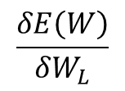
CNN Training: Backward Propagation
$$W_{L}$$
$$O_{L}$$
$$E(W)$$
$$y$$
$$\frac{δE\left(W\right)}{δW_{L}}$$
For a single image

Slide 12
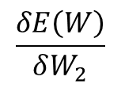
CNN Training: Backward Propagation
$$W_{2}$$
$$O_{2}$$
…
$$W_{L}$$
$$O_{L}$$
$$E(W)$$
$$y$$
$$\frac{δE\left(W\right)}{δW_{2}}$$
$$\frac{δE\left(W\right)}{δW_{L}}$$
For a single image

Slide 13
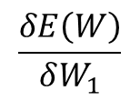
CNN Training: Backward Propagation
$$W_{1}$$
$$O_{1}$$
$$W_{2}$$
$$O_{2}$$
…
$$W_{L}$$
$$O_{L}$$
$$E(W)$$
$$y$$
$$\frac{δE\left(W\right)}{δW_{1}}$$
$$\frac{δE\left(W\right)}{δW_{2}}$$
$$\frac{δE\left(W\right)}{δW_{L}}$$
For a single image

Slide 14
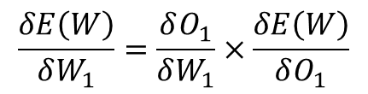
CNN Training: Backward Propagation
$$W_{1}$$
$$O_{1}$$
$$W_{2}$$
$$O_{2}$$
…
$$W_{L}$$
$$O_{L}$$
$$E(W)$$
$$y$$
$$\frac{δE\left(W\right)}{δW_{1}}=\frac{δO_{1}}{δW_{1}}×\frac{δE\left(W\right)}{δO_{1}}$$
For a single image

Slide 15
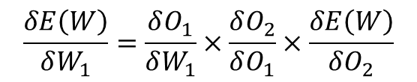
CNN Training: Backward Propagation
$$W_{1}$$
$$O_{1}$$
$$W_{2}$$
$$O_{2}$$
…
$$W_{L}$$
$$O_{L}$$
$$E(W)$$
$$y$$
$$\frac{δE\left(W\right)}{δW_{1}}=\frac{δO_{1}}{δW_{1}}×\frac{δO_{2}}{δO_{1}}×\frac{δE\left(W\right)}{δO_{2}}$$
For a single image

Slide 16
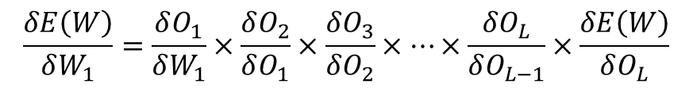
CNN Training: Backward Propagation
$$W_{1}$$
$$O_{1}$$
$$W_{2}$$
$$O_{2}$$
…
$$W_{L}$$
$$O_{L}$$
$$E(W)$$
$$y$$
$$\frac{δE\left(W\right)}{δW_{1}}=\frac{δO_{1}}{δW_{1}}×\frac{δO_{2}}{δO_{1}}×\frac{δO_{3}}{δO_{2}}×…×\frac{δO_{L}}{δO_{L−1}}×\frac{δE\left(W\right)}{δO_{L}}$$
For a single image

Slide 17
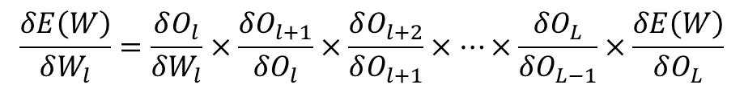
Training
$$E\left(W\right): \min_{W}{∑(y_{i} −{F(x}_{i}:W))^2}$$
$$W_{t+1}←W_{t}−α\frac{δE(W)}{δW}$$
$\frac{δE(W)}{δW}=2∑\left(y_{i} −F\left(x_{i}:W\right)\right)×\frac{δF(x_{i}:W)}{δW}$
Iteratively
For all samples, in each iteration
Error
For multiple images in a batch: Simply sum up the gradients
$$\frac{δE\left(W\right)}{δW_{l}}=\frac{δO_{l}}{δW_{l}}×\frac{δO_{l+1}}{δO_{l}}×\frac{δO_{l+2}}{δO_{l+1}}×…×\frac{δO_{L}}{δO_{L−1}}×\frac{δE\left(W\right)}{δO_{L}}$$

Slide 18
Training a Machine Learning Model
Partition dataset into batches
Epoch: Until all batches are covered
Read a batch from memory
iteration
Forward Propagation
Error Calculation
Backward Propagation

Slide 19
Data Parallel Distributed Training
Partition dataset into batches
Epoch: Until all batches are covered
Mini batches further partitioned in independent subsets.
Each subset performs the iteration in parallel
Need synchronization???
Read a batch from memory
iteration
Forward Propagation
Error Calculation
Backward Propagation

Slide 20

Gradient Update
$$W←W −α\frac{δE\left(W\right)}{δW}$$
Lets dig deeper into Gradient Update

Slide 21

Gradient Update
For a mini-batch with $M$ samples and mean squared error
$E\left(W\right)= \sum_{i=1}^{M}{E_{i}(W)}$
$E_{i}\left(w\right)={\left(O_{Li} −y_{i}\right)}^{2}$
$\frac{δE\left(W\right)}{δW}=\sum_{i=1}^{M}{\frac{δE_{i}\left(W\right)}{δW}}$

Slide 22
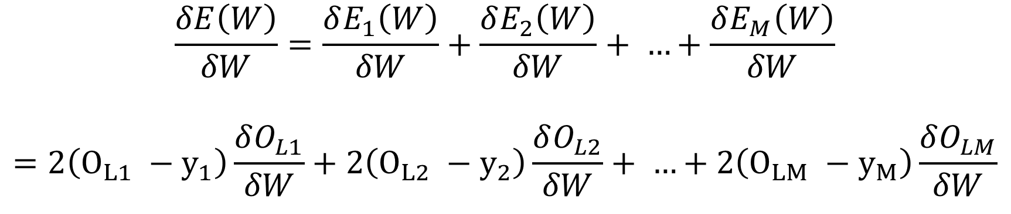
Gradient Update
$$\frac{δE\left(W\right)}{δW}=\frac{δE_{1}\left(W\right)}{δW}+\frac{δE_{2}\left(W\right)}{δW}+ …+\frac{δE_{M}\left(W\right)}{δW}$$
$$=2\left(O_{L1} −y_{1}\right)\frac{δO_{L1}}{δW}+2\left(O_{L2} −y_{2}\right)\frac{δO_{L2}}{δW}+ …+2\left(O_{LM} −y_{M}\right)\frac{δO_{LM}}{δW}$$
Can be calculated in parallel

Slide 23
Gradient Update
$$\frac{δE\left(W\right)}{δW}=\frac{δE_{1}\left(W\right)}{δW}+\frac{δE_{2}\left(W\right)}{δW}+ …+\frac{δE_{M}\left(W\right)}{δW}$$
$$=2\left(O_{L1} −y_{1}\right)\frac{δO_{L1}}{δW}+2\left(O_{L2} −y_{2}\right)\frac{δO_{L2}}{δW}+ …+2\left(O_{LM} −y_{M}\right)\frac{δO_{LM}}{δW}$$
Forward propagation in parallel – Need multiple copies of model

Slide 24
Gradient Update
$$\frac{δE\left(W\right)}{δW}=\frac{δE_{1}\left(W\right)}{δW}+\frac{δE_{2}\left(W\right)}{δW}+ …+\frac{δE_{M}\left(W\right)}{δW}$$
$$=2\left(O_{L1} −y_{1}\right)\frac{δO_{L1}}{δW}+2\left(O_{L2} −y_{2}\right)\frac{δO_{L2}}{δW}+ …+2\left(O_{LM} −y_{M}\right)\frac{δO_{LM}}{δW}$$
Error Calculation in parallel

Slide 25
Gradient Update
$$\frac{δE\left(W\right)}{δW}=\frac{δE_{1}\left(W\right)}{δW}+\frac{δE_{2}\left(W\right)}{δW}+ …+\frac{δE_{M}\left(W\right)}{δW}$$
$$=2\left(O_{L1} −y_{1}\right)\frac{δO_{L1}}{δW}+2\left(O_{L2} −y_{2}\right)\frac{δO_{L2}}{δW}+ …+2\left(O_{LM} −y_{M}\right)\frac{δO_{LM}}{δW}$$
Backward Propagation in parallel

Slide 26
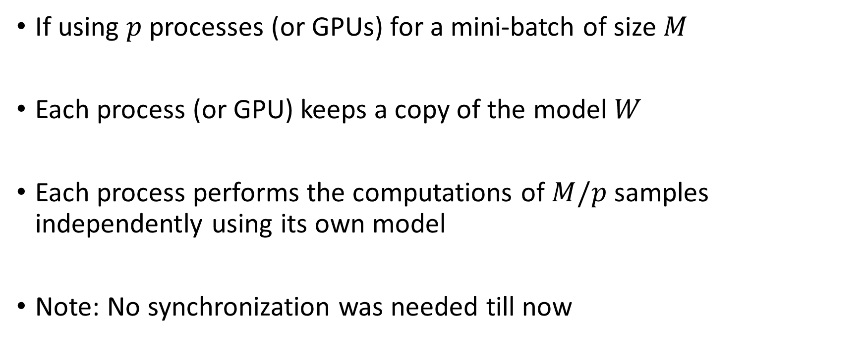
Gradient Update
If using $p$ processes (or GPUs) for a mini-batch of size $M$
Each process (or GPU) keeps a copy of the model $W$
Each process performs the computations of $M/p$ samples independently using its own model
Note: No synchronization was needed till now

Slide 27

Gradient Update
Weight Update Step:
$$W←W −α\frac{δE\left(W\right)}{δW}$$
No synchronization needed till now.

Slide 28

Gradient Update
Weight Update Step:
$$W←W −α\frac{δE\left(W\right)}{δW}$$
Do we need synchronization now???

Slide 29
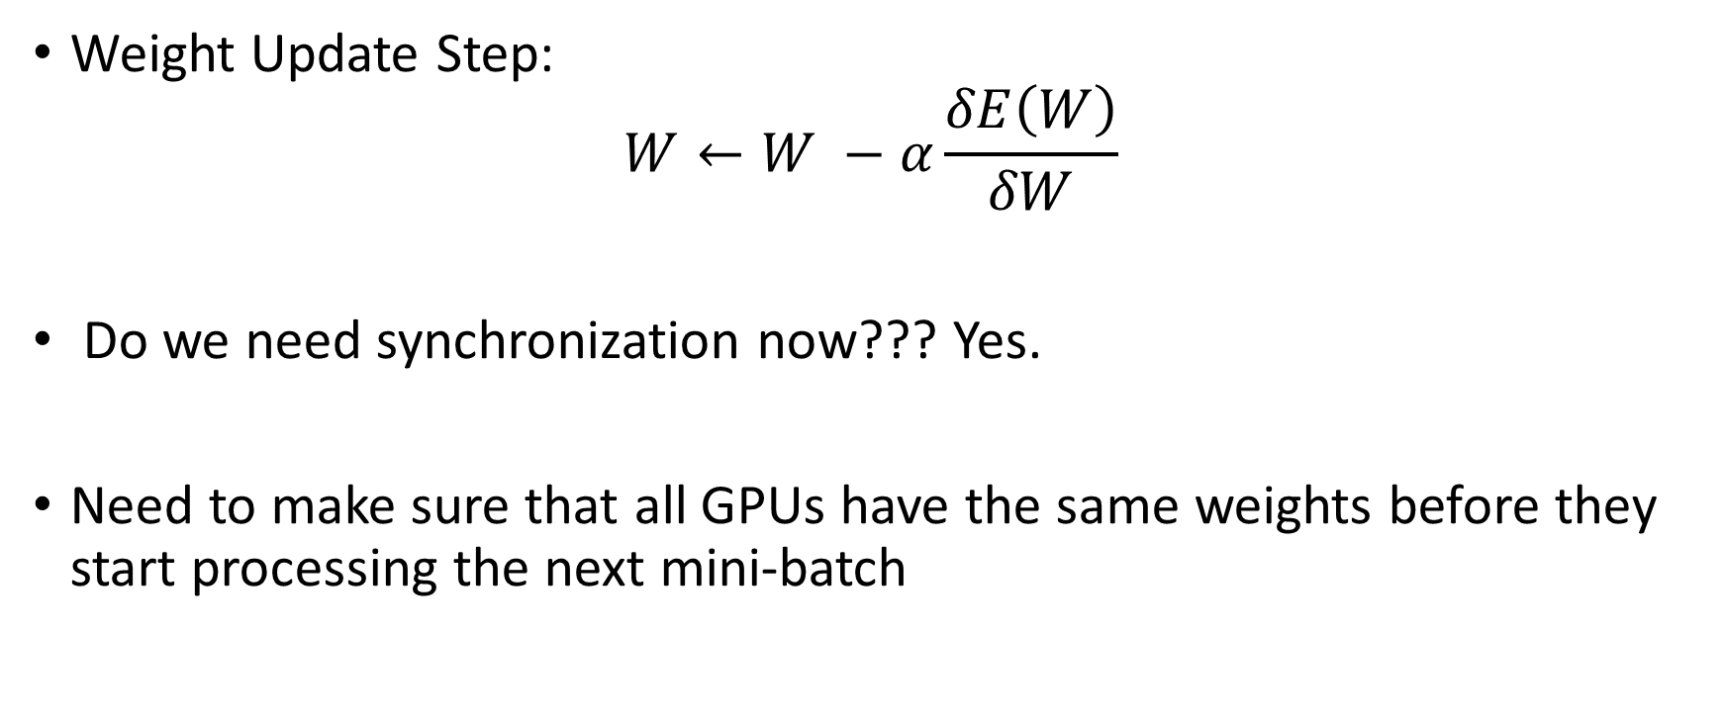
Gradient Update
Weight Update Step:
$$W←W −α\frac{δE\left(W\right)}{δW}$$
Do we need synchronization now??? Yes.
Need to make sure that all GPUs have the same weights before they start processing the next mini-batch

Slide 30
Data Parallel Distributed Training
Partition dataset into batches
Epoch: Until all batches are covered
Read a batch from memory
After each iteration, all parallel processors should use the same model weights to do the forward propagation on their portion of mini-batch
iteration
Forward Propagation
Error Calculation
Backward Propagation

Slide 31
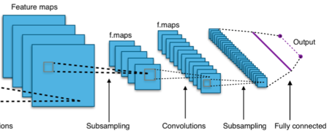

Data Parallel Training of Neural Networks
Synchronization of Gradients
Accelerator
Accelerator
Accelerator
Data
Data
Data
Minibatch $i$

Slide 32
Data Parallel Training of Neural Networks
How do we synchronize?
Model #1: Parameter Server Model
A dedicated server performs the weight updates and distributes the models to all the workers
Resource: Li, Mu, et al. "Scaling distributed machine learning with the parameter server." 11th USENIX Symposium on operating systems design and implementation (OSDI 14). 2014.
Cui, H., Zhang, H., Ganger, G. R., Gibbons, P. B., & Xing, E. P. (2016, April). Geeps: Scalable deep learning on distributed gpus with a gpu-specialized parameter server. In Proceedings of the eleventh european conference on computer systems (pp. 1-16).

Slide 33
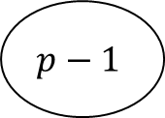

Parameter Server Model
Parameter Server
$$W$$
Data Parallel GPUs
0
1
$$p−1$$

Slide 34



Parameter Server Model
Parameter Server
$$W$$
$$W$$
$$W$$
$$W$$
Data Parallel GPUs
0
1
$$p−1$$

Slide 35
Parameter Server Model
Parameter Server
$$W$$
$$W$$
$$W$$
$$W$$
Data Parallel GPUs
Forward/Backward/
Gradient Calculation
0
1
$$p−1$$

Slide 36



Parameter Server Model
Parameter Server
$$W$$
$$δW^{0}$$
$$δW^{1}$$
$$δW^{p−1}$$
$$W$$
$$W$$
$$W$$
Data Parallel GPUs
0
1
$$p−1$$

Slide 37

Parameter Server Model
Parameter Server
$$∑δW$$
$$W$$
$$δW^{0}$$
$$δW^{1}$$
$$δW^{p−1}$$
$$W$$
$$W$$
$$W$$
Data Parallel GPUs
0
1
$$p−1$$

Slide 38
Parameter Server Model
Parameter Server
$$∑δW$$
$$W$$
This operation of collecting data from different processors and aggregating them is called Reduce – We will discuss more when we discuss cluster of accelerators
$$δW^{0}$$
$$δW^{1}$$
$$δW^{p−1}$$
$$W$$
$$W$$
$$W$$
Data Parallel GPUs
0
1
$$p−1$$

Slide 39

Parameter Server Model
Parameter Server
$$W′$$
$$W$$
$$W$$
$$W$$
Data Parallel GPUs
0
1
$$p−1$$

Slide 40



Parameter Server Model
Parameter Server
$$W′$$
$$W′$$
$$W′$$
$$W′$$
Data Parallel GPUs
0
1
$$p−1$$

Slide 41



Parameter Server Model
Parameter Server
$$W′$$
This operation of sending the same data from a single source to different processors is called Broadcast – We will discuss more when we discuss cluster of accelerators
$$W′$$
$$W′$$
$$W′$$
Data Parallel GPUs
0
1
$$p−1$$

Slide 42
Data Parallel Training of Neural Networks
How do we synchronize?
Model #2: All-reduce based Synchronization
No dedicated parameter server. Each worker calculates the gradients and broadcasts it to all other workers
Each worker aggregates the gradients collected by all other workers and performs the update step
Iandola, F. N., Moskewicz, M. W., Ashraf, K., & Keutzer, K. (2016). Firecaffe: near-linear acceleration of deep neural network training on compute clusters. In Proceedings of the IEEE conference on computer vision and pattern recognition (pp. 2592-2600).

Slide 43

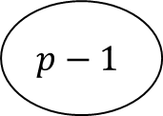


All Reduce Operation
Each processor collects data from all the other processors and performs a reduce operation
$$a_{0}$$
$$a_{1}$$
$$a_{p−1}$$
0
1
…
$$p−1$$

Slide 44









All Reduce Operation
Each processor collects data from all the other processors and performs a reduce operation
$$a_{p−1}$$
$$a_{p−1}$$
$$a_{p−1}$$
…
…
…
$$a_{1}$$
$$a_{1}$$
$$a_{1}$$
$$a_{0}$$
$$a_{0}$$
$$a_{0}$$
0
1
$$p−1$$
…

Slide 45
All Reduce Operation
Each processor collects data from all the other processors and performs a reduce operation
$$a_{p−1}$$
$$a_{p−1}$$
$$a_{p−1}$$
+
+
+
…
…
…
+
+
+
$$a_{1}$$
$$a_{1}$$
$$a_{1}$$
+
+
+
$$a_{0}$$
$$a_{0}$$
$$a_{0}$$
0
1
$$p−1$$
…

Slide 46



All Reduce Operation
Each processor collects data from all the other processors and performs a reduce operation
We will discuss how to efficiently implement this on a cluster of accelerators later in the class
$${∑a}_{i}$$
$${∑a}_{i}$$
$${∑a}_{i}$$
0
1
$$p−1$$
…

Slide 47
All Reduce Model
$$W$$
$$W$$
$$W$$
Data Parallel GPUs
0
1
$$p−1$$

Slide 48
All Reduce Model
$$W$$
$$W$$
$$W$$
Data Parallel GPUs
Forward/Backward/
Gradient Calculation
0
1
$$p−1$$

Slide 49
All Reduce Model
$$δW^{0}$$
$$δW^{1}$$
$$δW^{p−1}$$
$$W$$
$$W$$
$$W$$
Data Parallel GPUs
0
1
$$p−1$$

Slide 50
All Reduce Model
$$δW^{0}$$
$$δW^{1}$$
$$δW^{p−1}$$
$$W$$
$$W$$
$$W$$
Data Parallel GPUs
0
1
$$p−1$$
All Reduce Gradients

Slide 51



All Reduce Model
$$∑δW^{i}$$
$$∑δW^{i}$$
$$∑δW^{i}$$
$$W$$
$$W$$
$$W$$
Data Parallel GPUs
0
1
$$p−1$$
All Reduce Gradients

Slide 52
All Reduce Model
$$W′$$
$$W′$$
$$W′$$
Data Parallel GPUs
0
1
$$p−1$$

Slide 53
Model Parallel Distributed Training
Data Parallelism
Weights are replicated on each GPU
What if the model is too big for a single GPU?
Model Parallelism: Split the model across GPUs

Slide 54

Model Parallel Distributed Training
Data Parallel
GPUs
0
$$W_{1}$$
$$O_{1}$$
$$W_{2}$$
$$O_{2}$$
…
$$W_{L}$$
1
$$W_{1}$$
$$O_{1}$$
$$W_{2}$$
$$O_{2}$$
…
$$W_{L}$$
$$p−1$$
$$W_{1}$$
$$O_{1}$$
$$W_{2}$$
$$O_{2}$$
…
$$W_{L}$$

Slide 55
Model Parallel Distributed Training
2
0
$$W_{1}$$
$$O_{1}$$
$$W_{2}$$
$$O_{2}$$
…
$$W_{L}$$
1
3
Partition the model across GPUs

Slide 56
Model Parallel Distributed Training
Different ways to partition the model
Layerwise Partitioning – Pipeline Parallelism
Intra-Layer Partitioning – Tensor Parallelism

Slide 57

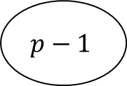
Pipeline Parallelism
Batch of inputs: e.g., 64 images
$$I$$
$$W_{1}$$
$$O_{1}$$
$$W_{2}$$
$$O_{2}$$
$$W_{L}$$
0
1
$$p−1$$

Slide 58
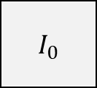
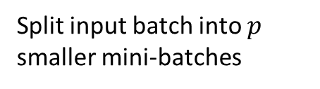
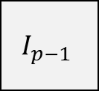
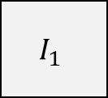
Pipeline Parallelism
Split input batch into $p$ smaller mini-batches
$I_{0}$
$$I_{1}$$
$$W_{1}$$
$$O_{1}$$
$$W_{2}$$
$$O_{2}$$
$$W_{L}$$
$$I_{p−1}$$
0
1
$$p−1$$

Slide 59


Pipeline Parallelism
$I_{0}$
$$I_{1}$$
$$W_{1}$$
$$O_{1}$$
$$W_{2}$$
$$O_{2}$$
$$W_{L}$$
$$I_{p−1}$$
0
1
$$p−1$$
Process Layer 1 for Batch $I_{0}$ in GPU 0

Slide 60

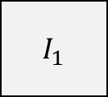
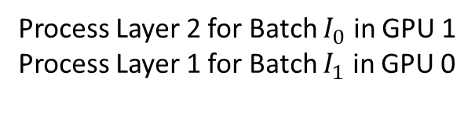
Pipeline Parallelism
$I_{1}$
$I_{0}$
$$I_{1}$$
$$W_{1}$$
$$O_{1}$$
$$W_{2}$$
$$O_{2}$$
$$W_{L}$$
$$I_{p−1}$$
0
1
$$p−1$$
Process Layer 2 for Batch $I_{0}$ in GPU 1
Process Layer 1 for Batch $I_{1}$ in GPU 0

Slide 61
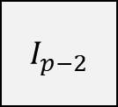
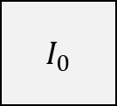
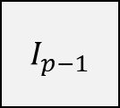
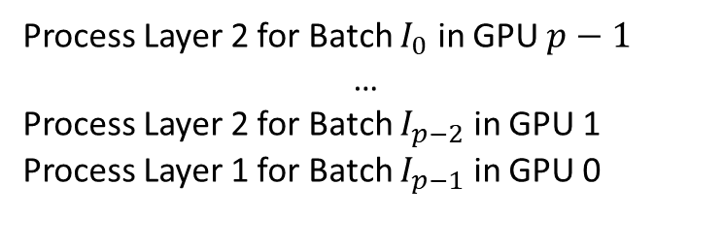
Pipeline Parallelism
$I_{p−1}$
$I_{p−2}$
$I_{0}$
$$I_{1}$$
$$W_{1}$$
$$O_{1}$$
$$W_{2}$$
$$O_{2}$$
$$W_{L}$$
$$I_{p−1}$$
0
1
$$p−1$$
Process Layer 2 for Batch $I_{0}$ in GPU $p−1$
…
Process Layer 2 for Batch $I_{p−2}$ in GPU 1
Process Layer 1 for Batch $I_{p−1}$ in GPU 0

Slide 62
Pipeline Parallelism
When and what communications are needed?

Slide 63
Pipeline Parallelism
When and what communications are needed?
Need to communicate the activations after each layer
In backward propagation, need to communicate gradients.

Slide 64

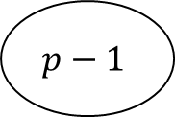

Tensor Parallelism
Batch of inputs: e.g., 64 images
0
$$I$$
1
$$W_{1}$$
$$p−1$$
Partition across the embedding dimension of the inputs

Slide 65

Tensor Parallelism
Batch of inputs: e.g., 64 images
0
$$I$$
1
$$W_{1}$$
$$p−1$$
In each layer, each GPU applies a portion of the weights to its portion of the input

Slide 66



Tensor Parallelism
Batch of inputs: e.g., 64 images
0
$$O_{1}$$
$$I$$
1
$$O_{1}$$
$$W_{1}$$
$$p−1$$
$$O_{1}$$
GPU communicate to collective produce output of the layer – Each GPU will get a copy of the output

Slide 67


Tensor Parallelism
Batch of inputs: e.g., 64 images
0
$$O$$
1
$$W_{2}$$
$$p−1$$
Output is again partitioned across the embedding dimension to serve as input to the next layer

Slide 68
3D Parallelism
In practice, all three parallelisms are combined
Data + Pipeline + Tensor = 3D parallelism
DeepSpeed: https://github.com/microsoft/DeepSpeed/tree/master?tab=readme-ov-file

Slide 69
3D Parallelism
We will discuss the communication and computation optimizations for distributed training in detail when we are looking into cluster of accelerators

Slide 70
Outline
Distributed Training Basics
Pytorch Lightning

Slide 71

PyTorch Lightning
Facilitating Deep Learning
An open source Python library created in 2019.
Offers high-level wrappers for PyTorch.
Aims to decouple research from engineering.

Slide 72
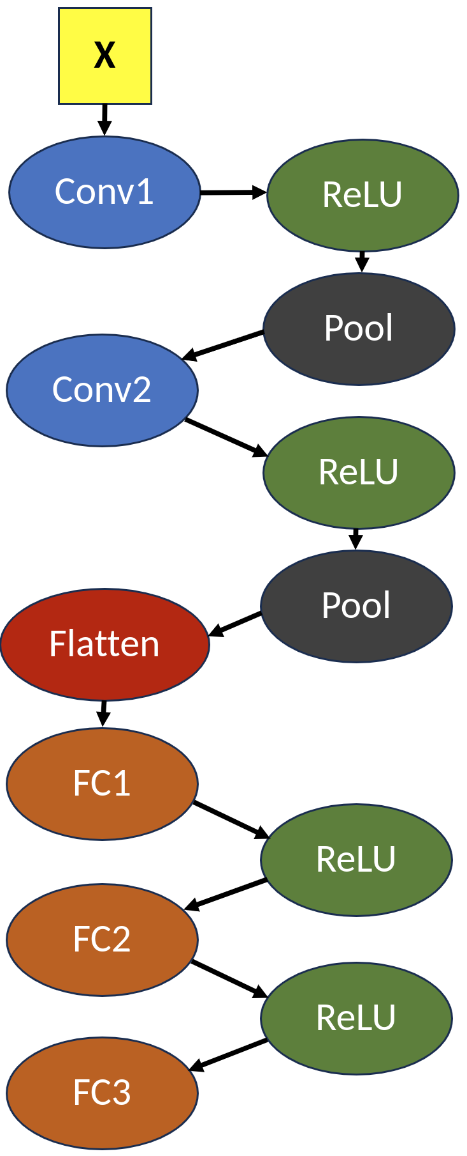
Pytorch Lightning – Distributed Training
Supports Distributed Data Parallel and variants https://lightning.ai/docs/pytorch/stable/accelerators/gpu_intermediate.html
Supports Data+Model Parallel – Fully Sharded Data Parallel
Model weights are partitioned
https://lightning.ai/docs/pytorch/stable/advanced/model_parallel/fsdp.html
Sharded Model
#1
Sharded Model
#2
Sharded Model
#N
GPU #1
GPU #2

Slide 73
Pytorch Lightning – Distributed Training
Most of the programming remains similar to PyTorch
Some additions/modifications include:
Define a sub-class of LightningModule to define interactions between the various layers of your models – PyTorch Lightning uses this information to perform FSDP
Define training_step within this module – enables PyTorch Lightning to optimizing training step
Configure optimizers within this module - enables PyTorch Lightning to apply optimizer specific optimizations

Slide 74
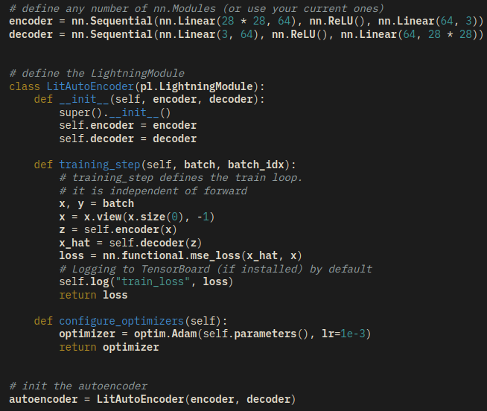
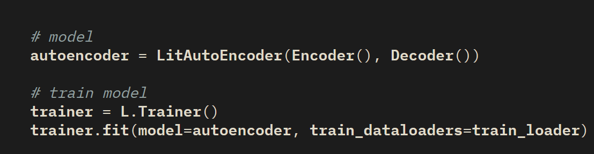
Pytorch Lightning – Distributed Training
Instead of Training Loop, we have the following

Slide 75
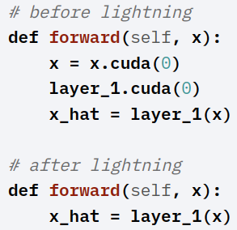
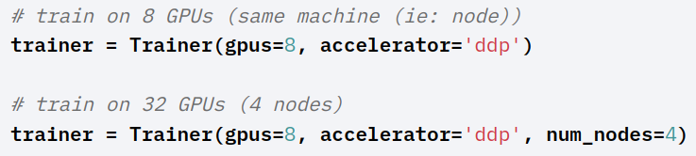
Pytorch Lightning – Acceleration and Parallelization
You don’t need to explicitly specify the device
You can achieve parallel training by simply setting the number of gpus and policy
ddp – distributed data parallel
Fsdp – Fully Sharded Data Parallel
Requires additional information on which layers to shard

Slide 76
Pytorch Lightning – For you to Review
Pytorch Lightning Training Basics - https://lightning.ai/docs/pytorch/stable/model/train_model_basic.html
Training on GPU - https://lightning.ai/docs/pytorch/stable/accelerators/gpu_basic.html
Distributed Training - https://lightning.ai/docs/pytorch/stable/levels/advanced_level_21.html

Slide 77
Next Class
10/16 Lecture 15
Acceleration of Transformer Models: Basics

Slide 78
Thank You
Questions?
Email: sanmukh.kuppannagari@case.edu

